Slide 1

Presented by
Yash Ingle

Slide 2




FOUR CHAPTERS IN PROJECT
1
2
3
4
Introduction
Problems
Data Findings
Recommendations

Slide 3
FOUR CHAPTERS IN PROJECT
Introduction
Problems
Data Findings
Recommendations
This project explores user behavior in bike-sharing service.

Slide 4
FOUR CHAPTERS IN PROJECT
Problems
Introduction
Data Findings
Recommendations
Identifying challenges limiting membership growth and user retention

Slide 5
FOUR CHAPTERS IN PROJECT
Introduction
Data Findings
Problems
Recommendations
Analyzing ride patterns, usage trends, and seasonal behavior

Slide 6
FOUR CHAPTERS IN PROJECT
Introduction
Recommendations
Problems
Data Findings
Suggesting data-driven strategies to improve membership conversions

Slide 7

Introduction
About Cyclistic
Cyclistic is a bike-sharing company based in Chicago.
Offers both casual single rides and membership plans.
Operates a fleet of classic bikes, electric bikes and dockless options.
Aims to provide an affordable, eco-friendly urban transportation solution.
The marketing team is focused on increasing long-term memberships.

Slide 8
Project Overview
This analysis supports cyclistic’s goal to grow memberships.
Utilizes real ride data to uncover user behaviour patterns.
Compares casual riders and members across multiple dimensions.
Identifies opportunities to convert casual riders into loyal members.
Findings will drive targeted marketing and product strategy decisions.

Slide 9
Key Questions driving the Analysis
How do annual members and casual riders use Cyclistic bikes differently ?
Why would casual riders be motivated to buy annual memberships ?
How can cyclistic use digital media to influence casual riders to become members ?

Slide 10
Data Findings Overview
Overview of Key Insights from Ride Data
Analysis covered over 5.8 million rides in the past year.
Clear behaviour differences found between casual and member riders.
Differences observed in trip duration, frequency, time and seasonality.
Findings will help shape targeted strategies for conversion.

Slide 11
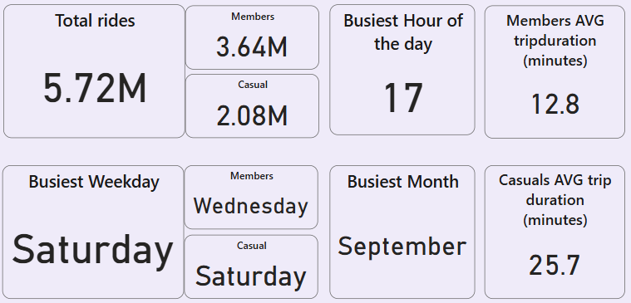
Key Metrics Summary
Total Rides: 5.72 Million
-Members: 3.64M (63.64%)
-Casual: 2.08M (36.36%)
Average Trip duration:
-Members: 12 mins
-Casual: 25 Mins
The Busiest Weekday:
-Members: Wednesday
-Casual: Saturday
Busiest Month : September
Busiest Hour : 17 i.e 5 pm

Slide 12
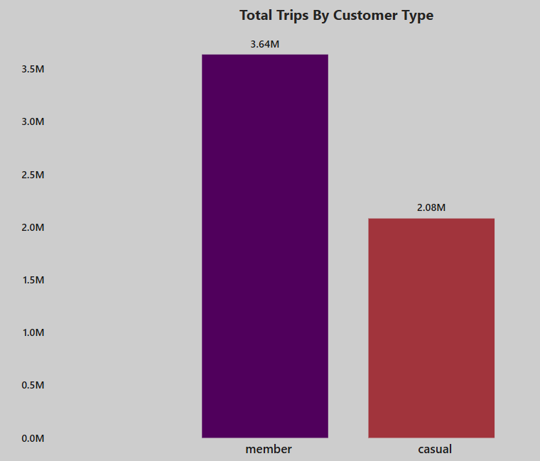
Total Rides by Customer Type
Members took the most rides at 63.64% of the total trips compared to 36.36% of Casual Riders

Slide 13
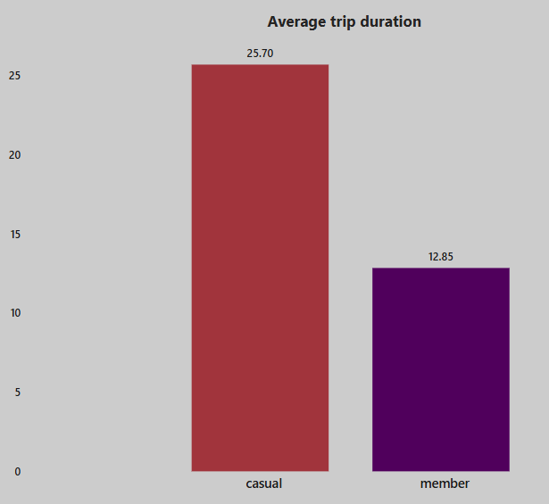
Average Ride Length
Casual riders averaged 25 mins per bike ride.
Members trip duration were way less than that averaging around 12 mins per ride.

Slide 14
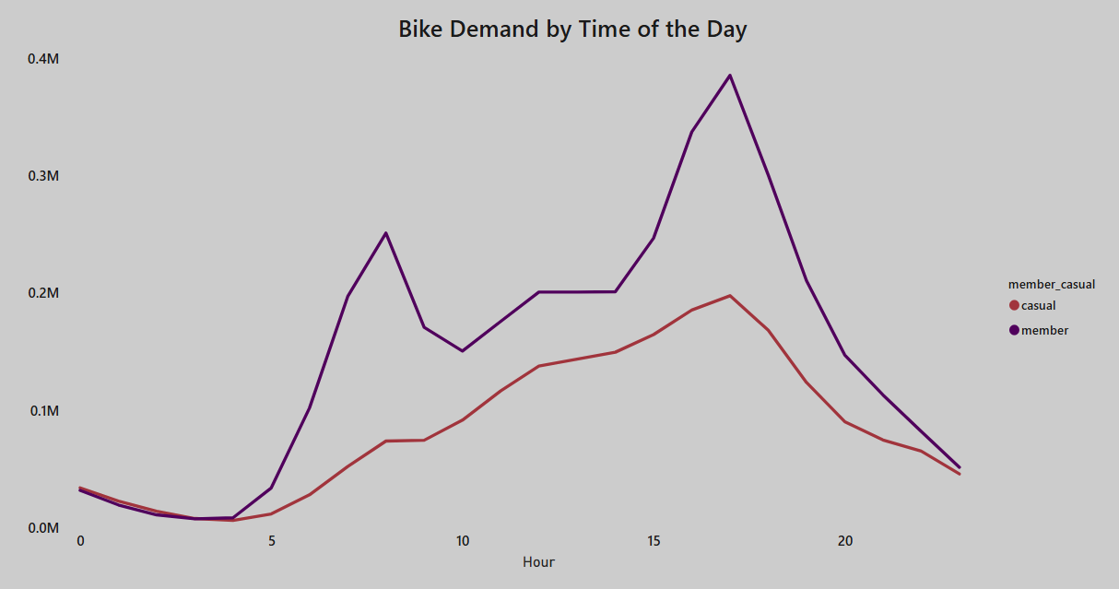
Bike Demand by Hour
The busiest time of the day for both the members and the casual riders was after lunch, peaking at 5 PM for both.

Slide 15
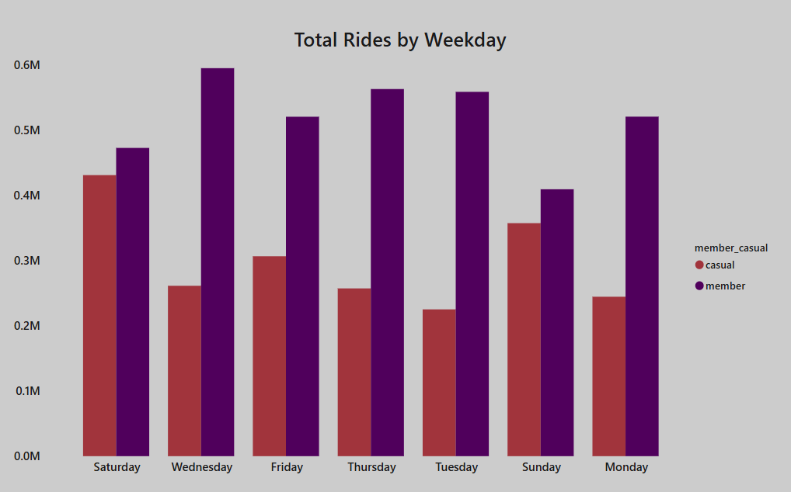
Total Rides by Weekday
The busiest weekdays for Members were Monday through Friday.
The busiest weekdays for Casual riders were Saturday and Sunday.

Slide 16
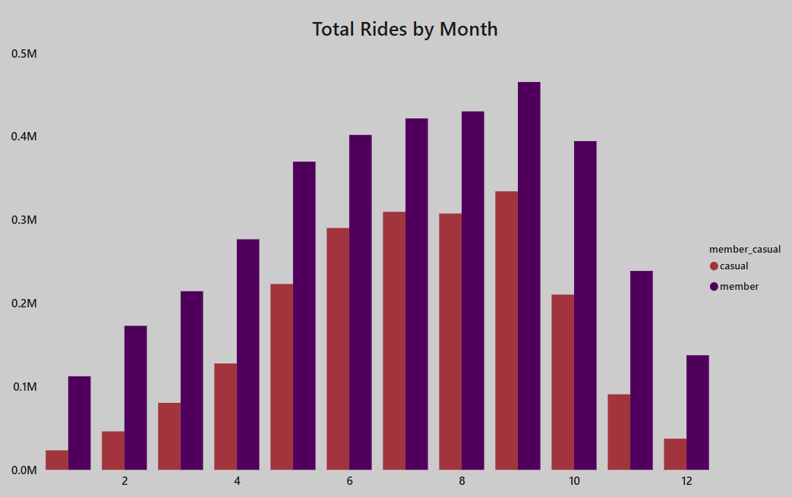
Total Rides by Month
The busiest season for both types of customer was the summer.
Members numbers remained high thorough October.
Casual riders were high from June to September.

Slide 17
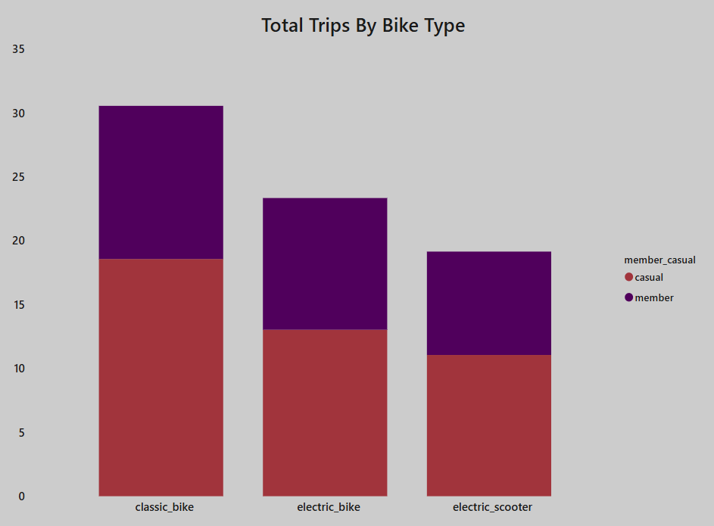

Total Rides by Bike Type
The most popular bike for both types of customer was Classic.
The least being the electric scooter.

Slide 18
Recommendations
🧲 1. Convert Casual Riders into Members
Launch tailored weekend/leisure membership plans with benefits aligned to casual rider behavior.
Offer ride-based loyalty rewards (e.g., free membership extensions after certain miles).
Run referral programs for free rides or discounts to incentivize peer sign-ups.
Provide seasonal membership offers during summer when ride activity is high.
📱 2. Enhance Digital Experience
Develop a mobile app with: - Bike geolocation + mobile unlocking
Visual stats (carbon saved, miles biked)
Loyalty rewards & exclusive member discounts

Slide 19
Recommendations
💸 4. Optimize Pricing & Plans
Introduce flexible pricing models (monthly, quarterly, annual).
Highlight annual plan cost savings to nudge commitment.
Offer long-ride discounts exclusive to members to appeal to leisure users.
🎯 3. Improve Targeted Marketing
Partner with tourist attractions for member-only perks (e.g., entry discounts).
Focus campaigns at popular casual rider stations to boost weekend conversions.
Use surveys to better understand casual rider needs and conversion barriers.

Slide 20
Summary
🔍 Key Findings
Members primarily ride during weekday rush hours, likely for work commutes.
Casual riders favor weekend rides, often longer and recreational in nature.
E-bikes are the top choice for both user types.
Summer months see peak ride volume; winter drop-off is sharper among casuals.
🎯 Strategic Highlights
Tailor membership options and promos to weekend leisure users.
Offer loyalty rewards, seasonal deals, and flexible pricing to drive conversions.
Improve digital presence via a dedicated mobile app with features that enhance user experience.
Collaborate with local content creators to document scenic rides around Chicago, boosting Cyclistic’s brand image and attracting new customers.

Slide 21



Thank you
For your time and attention
I appreciate the opportunity to present these findings and recommendations.
💬 I’m happy to answer any questions or feedback.
Feel free to share your thoughts or suggestions.
Connect with me:
yashingle.work@gmail.com
LinkedIn
GitHub

